Slide 1
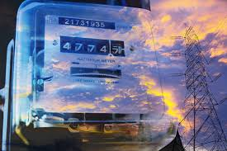

HAMZA EJAZ
B19102041

Slide 2
What is Electricity Bill?
The bill that a local utility issues to a consumer for the electricity that their home consumes. For this purpose, we have required an efficient bill calculator which generate bill with efficiency and save time of organizations. This problem is solved by the program that we discuss today.

Slide 3
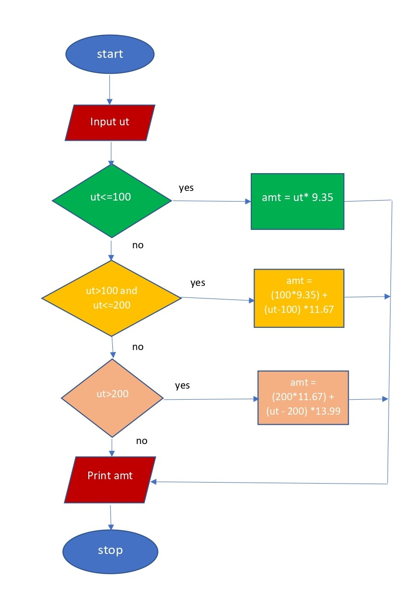
Flow Chart:

Slide 4
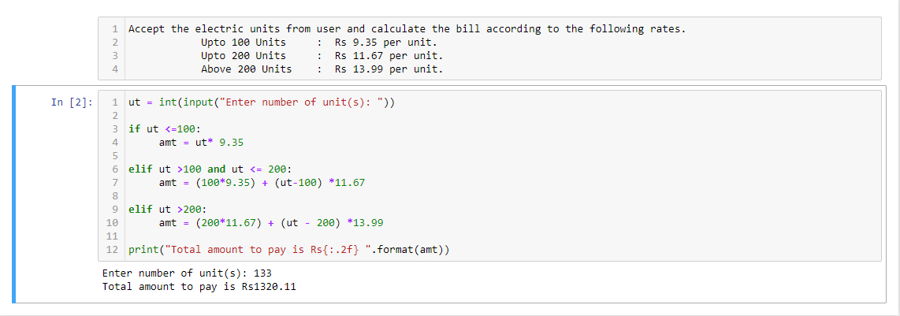
Source Code:

Slide 5
Inference Engine:
The inference engine is the component of the intelligent system in AI.
It applies logical rules to the knowledge base to infer new information from known facts.
The logic that an inference engine uses is typically represented as IF-THEN rules.
Focusing on IF-THEN statements, our solution to the problem has achieved.
So it concludes that electricity bill calculator is one of the application of inference engine.

Slide 6
THANK YOU ☺

